Slide 1
CS487-Introduction to competitive programming: A2SV
Lecture #9: Linked Lists, Binary Trees

Slide 2
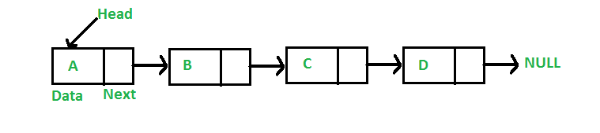
Linked List
Linear data structure
Elements are not stored at a contiguous location
Elements are linked using pointers

Slide 3
Linked List
Advantages
Dynamic size
Easy insert/delete
Disadvantages
No random access (need to access elements sequentially)
Extra memory use for pointers
Not cache friendly

Slide 4
Node
Elements of a linked list are called as nodes
Simple structures with data and next pointer
First node is conventionally called head
A linked list is usually referred and passed by its head

Slide 5
Node in C
struct Node {
int data;
struct Node* next;
};

Slide 6
Node in C++
class Node {
public:
int data;
Node* next;
};

Slide 7
Node in Java
class Node {
int data;
Node next;
Node(int d) {
data = d;
}
}

Slide 8
Node in Python
class Node:
def __init__(self, data):
self.data = data
self.next = None

Slide 9
Programming exercises
Reverse Linked List
Delete Node in a Linked List
Merge Two Sorted Lists
Remove Duplicates From a Sorted List
Reverse Nodes in K Group
Insertion Sort List
Next Greater Node in the Linked List
Design Linked List
Linked List

Slide 10
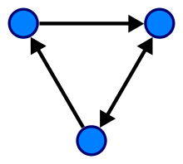
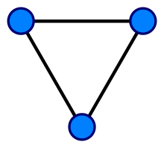
Graph
A graph is a pair G = (V, E), where V is a set whose elements are called vertices, and E is a set of edges (sometimes links or lines).
A directed graph is a graph in which edges have orientations.

Slide 11
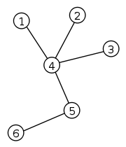
Tree
A tree is an undirected graph, in which any two vertices are connected by exactly one path
A tree with N vertices have N-1 edge
One can think of starting with only one vertice, and adding a vertice and an edge at each step to construct a tree
No cycles

Slide 12
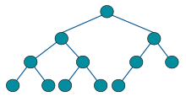
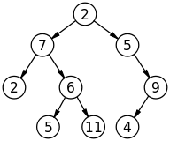
Binary Tree
A tree with each node has at most 2 edges
Note that it does not have to be complete
A complete binary tree is completely filled except the last level

Slide 13
Tree As a Data Structure
Trees are hierarchical data structures
Unlike arrays, linked lists, stacks, queues
Maximum nodes at level i
Maximum # of nodes in a binary tree with height h
Min number of levels with L leaves
Full binary tree leaf count vs internal node count

Slide 14
Binary Tree Node in C++
class Node {
public:
int data;
Node* left;
Node* right;
};

Slide 15
Programming exercises
Range Sum of BST
Merge Two Binary Trees
Search in a BST
Same Tree
Lowest Common Ancestor in a BST
Find Bottom Left Tree Value
Construct BST from Preorder Traversal
Maximum Binary Tree
Insert into BST
Binary Tree Postorder Traversal
Binary Trees

Slide 16
Quote of the day
"We are what we repeatedly do. Excellence then, is not an act, but a habit." —Will Durant

